Slide 1
Student Associations
Jump Start your Career!
Carletta Woods
April 26, 2012
VCARA

Slide 2
Member Benefits
Share and learn with fellow students
Leadership opportunities
Cultivate Professional contacts
Develop Skills for professional career
Explore career options
And provided greater access to the national organization
Participate in conference activities
Scholarships to attend national conferences
Meet and networks with others in your chosen profession
Participate in mentor program
Notes:
Some students say that they don’t have time to join student associations while in graduate school. It’s already difficult to juggle work and school. Adding another activity or obligation will add stress to their already busy schedules.
I can understand how this particular view is held by some, after all one of the reasons that we at SJSU are participating in a distance learning program is so that we can better coordinate employment and school responsibilities.
However, I would encourage all SLIS and MARA students to think about Student Associations as an opportunity for career guidance and advancement.
Student associations offer distance learners a ways to connect with other students
We may find others who have already taken classes that we are interested in taking
Meet others who are willing to share their work or internship experiences
Get advice on classes to take, volunteer or internship opportunities
Meet students who are already working in the information field who may have tips on how to get a foot in the door in a particular industry.
Student associations also provide a link to the national organizations within our Information industry. Many national organizations provide scholarships for students to attend their conferences, which in turn provides students with access to the culture of the industry as well as meet potential employers.
Student chapters of the national organizations often organize events that allow students to explore career options other than librarianship. Experiences that can open up the possibilities for our future in information. It also allows contact with professionals who can help guide one’s career.
There are four student associations options for SJSU SLIS Students. They are:
SLISConnect
American Library Association Student Chapter (A-L-A-S-C)
American Society for Information Science and Technology (ASIS&T) Student Chapter
Society of American Archivist Student Chapter
The virtual association is here in VCARA

Slide 3
SLISConnect
SLISConnect is a student and alumni networking group.
“SLISConnect aims to foster connections between current and former students of the SJSU SLIS program through our communications, events, and programs.”
Notes:
SLIS Connect is a student and alumni networking group, which allows students opportunities to connect, share experiences and advice with fellow students. It also provides an avenue for students to meet alumni who have 1) accomplished what they are trying to do 2) may have specific advice on career options or development, and potentially find a mentor.

Slide 4
American Library Association
Foster participation in the American Library Association and use of its publications, scholarships and conferences
Encourage scholarly achievement and professional awareness of national issues in library and information science;
Provide a local forum for the exchange of ideas and information about trends, issues, and opportunities in the profession
Provide a supportive environment in which members can share their creativity, teach their skills, offer their experience, direct their expertise, and learn from each other.
Notes:
ALA-Student Chapter is a great resource for students, in particular those who are seeking careers in librarianship, but by no means is this limited to working in a traditional library. The student group provides information on activities at the ALA national level as well as information on local events. It is a platform for you to find out what is happening in your area or let other know about ALA related events that you know are happening near you. Students support the exchange of ideas and trends in the library profession, share their experiences and encourage scholarly achievement.

Slide 5
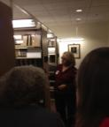
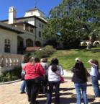
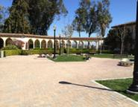
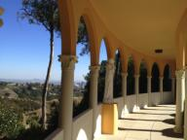
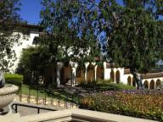
Society of American Archivist
Provides a sense of community among the students in the SJSU SLIS Archival Studies program track.
Helps students connect with each other and professional archivists.
Provides tours to repositories for students in various locations around the country.
Notes:
The SAA Student Chapter works diligently to provide students access to archivist and archives whereever students are located. The student group organizes tours, provides information on additional training or workshops for archivist, and access to information about events happening at the national level.
In March I was able to attend the SAASC sponsored tour to Mount St. Mary’s College Archives at the Charles Willard Coe Memorial Library. The school has two locations one near downtown Los Angeles and the other in the hills of Brentwood over looking the Pacific. Many of you may know the archivist, Vicky McCargar, who is also part of the SLIS faculty. You can see her in the first picture on the left as she tells students about the history of the archives.

Slide 6
American Society for Information Science and Technology (ASIS&T)
“The society for information professionals leading the search for new and better theories, techniques, and technologies to improve access to information.”
Provides students:
a place to share their special interests and run programs for students and other members of the community with an interest in information science
with experience in being active ASIS&T members, and the opportunity to contribute to personal growth and career development.
Notes:
American Society for Information Science and Technology (ASIST) Student Chapter is back this year, after not being active for a while. Full disclosure, I am a member of both the SAASC and ASIST student chapters. And the 2011-2012 vice chair for ASIST so I admit that I may have some bias.
What I like most about the ASIST student chapter this year were the presentations by SJSU faculty and students, as well as guest speakers from the information industry

Slide 7
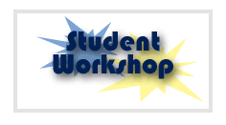
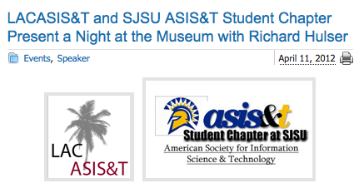
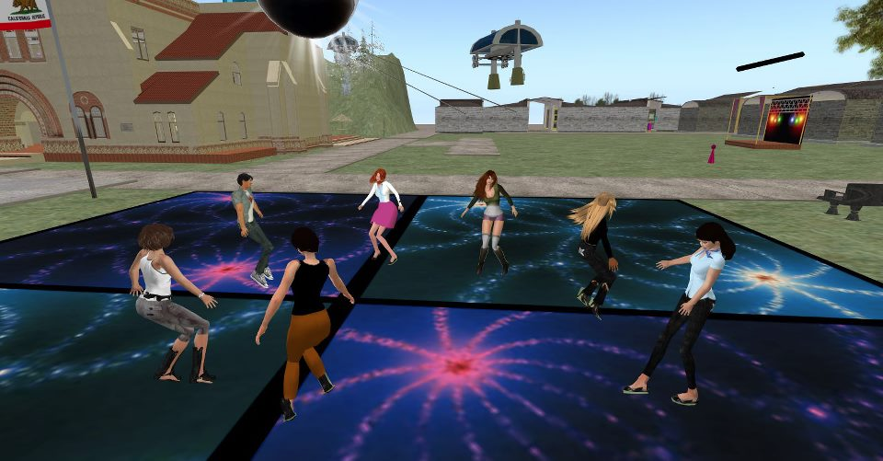
Speaker Series
Topics cover professional, academic, and/or research experience in the fields of Library, Information Science, and Technology.
Faculty Prime Time - presentations conducted by current San Jose State University professors.
Student Workshops – current student members provide information on technology tools for school and employment or career experience.
Joint Presentations or Events with Local ASIS&T Professional Chapters and Other Student Association Groups
Joint Student Chapters SL Mixer
Notes:
The presentations, held in Blackboard collaborate, were as profound as many class lectures. The professional speakers were clearly excited about the topics that they presented and welcomed questions from students about careers and about their areas of expertise. They were also very amenable to hearing from students outside of the presentation for those who wanted to know more about their work.
Student presentation were equally interesting as many students have had or still have careers that are related to information science. Students sharing their experience and expertise can often provide insight into career options that others have not considered. For some, it may be easier to ask a fellow student more about their career experience than contacting a professor. But either option is available through the student chapter events.
The speaker series provided me with an emersion into information science that I would not have experienced without belonging to student chapter. That holds true for my experience with SAASC as well.
In March of this year, the Student Chapters of the ALA, SAA, and ASIST held a Student Mixer in Second Life. I was part of coordinating that event and I must say that I feel as though I made a new set of friends from the experience. I never would have connected with the other students had it not been for planning that event. And of course the event itself was great fun.

Slide 8
Links to Student Chapters Join Today
SLIS CONNECT
http://www.facebook.com/SLISConnect
ALASC
https://slisgroups.sjsu.edu/alasc/
ASIS&T Student Chapter
http://slisgroups.sjsu.edu/asistsc/
SAASC
http://slisgroups.sjsu.edu/saasc/
Notes:
As online or distance learners, we don’t have the same types of opportunities as students on campus to access career guidance or social opportunities with other students, faculty, or guest lecturers from a specific field. Membership and participation in SLIS student associations provides additional career and professional opportunities to distance learners and the opportunity to engage fellow students. I strongly encourage you to join one or more of the student chapters today. Visit the sites listed here to learn more.
Thank you.

